Slide 1


Slide 2


Slide 3


Slide 4
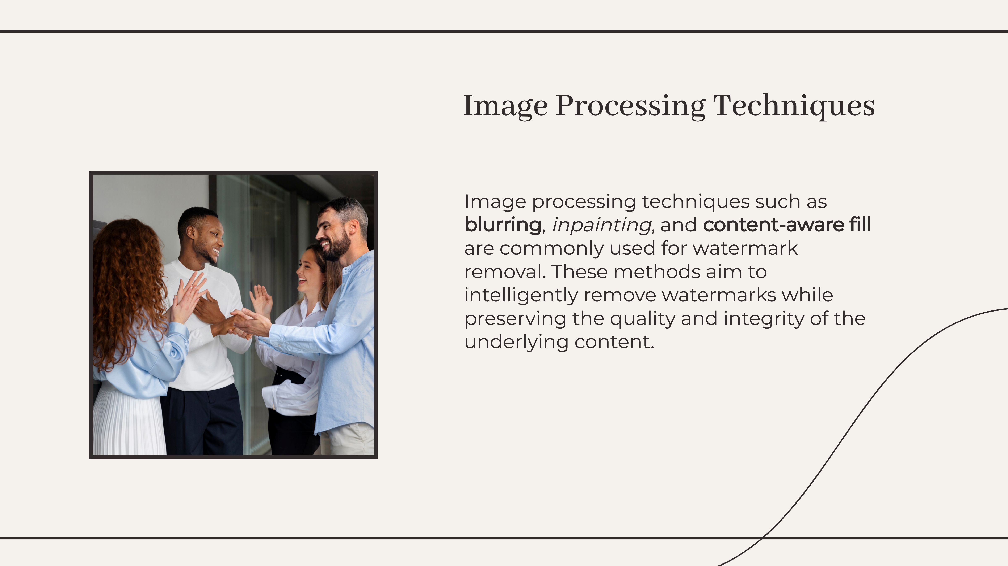

Slide 5


Slide 6
CODE:
import cv2
def remove_watermark_from_image(image_path, mask_path):
# Read the original image and its corresponding mask
image = cv2.imread(image_path)
mask = cv2.imread(mask_path, cv2.IMREAD_GRAYSCALE)
# Convert the mask to binary
ret, binary_mask = cv2.threshold(mask, 127, 255, cv2.THRESH_BINARY)
# Invert the binary mask
inverted_mask = cv2.bitwise_not(binary_mask)
# Apply the inverted mask to the original image
result = cv2.bitwise_and(image, image, mask=inverted_mask)
return result
def remove_watermark_from_video(video_path, mask_path, output_path):
# Open the video file
video_capture = cv2.VideoCapture(video_path)
# Get video properties
frame_width = int(video_capture.get(cv2.CAP_PROP_FRAME_WIDTH))
frame_height = int(video_capture.get(cv2.CAP_PROP_FRAME_HEIGHT))
fps = int(video_capture.get(cv2.CAP_PROP_FPS))
# Define the codec and create VideoWriter object
fourcc = cv2.VideoWriter_fourcc(*'mp4v')
video_writer = cv2.VideoWriter(output_path, fourcc, fps, (frame_width, frame_height))
# Read the watermark mask
mask = cv2.imread(mask_path, cv2.IMREAD_GRAYSCALE)
# Convert the mask to binary
ret, binary_mask = cv2.threshold(mask, 127, 255, cv2.THRESH_BINARY)
# Invert the binary mask
inverted_mask = cv2.bitwise_not(binary_mask)
# Process each frame in the video
while True:
ret, frame = video_capture.read()
if not ret:
break
# Apply the inverted mask to the frame
result = cv2.bitwise_and(frame, frame, mask=inverted_mask)
# Write the processed frame to the output video
video_writer.write(result)
# Release video objects
video_capture.release()
video_writer.release()
print("Watermark removal from video is complete.")
# Example usage for image:
image_path = 'input_image.jpg' # Path to the image with watermark
mask_path = 'watermark_mask.png' # Path to the mask of the watermark
output_image = remove_watermark_from_image(image_path, mask_path)
cv2.imwrite('output_image.jpg', output_image)
# Example usage for video:
video_path = 'input_video.mp4' # Path to the video with watermark
output_video_path = 'output_video.mp4' # Output video path without watermark
remove_watermark_from_video(video_path, mask_path, output_video_path)

Slide 7
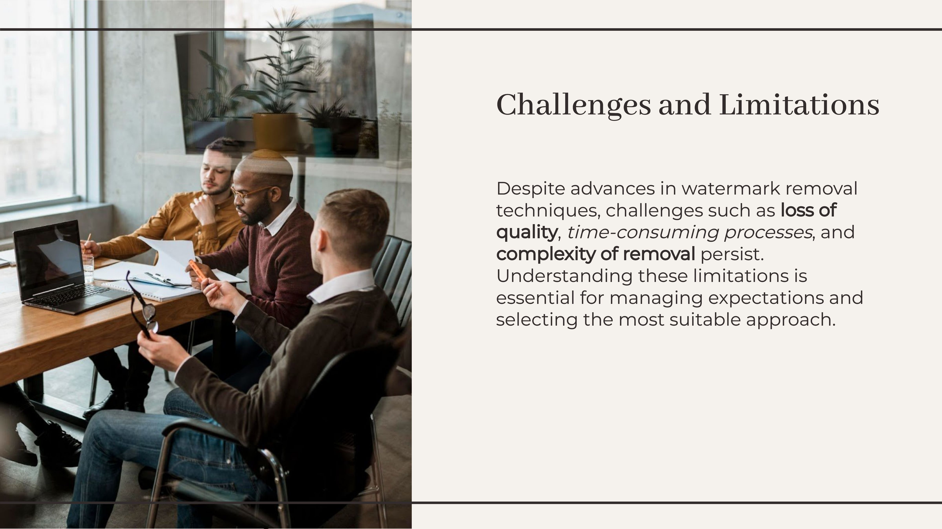

Slide 8


Slide 9


